Slide 1
Divine Jealousy – Sometimes it is Godly to be Jealous
YHWH is jealous that His people worship YHWH and YHWH alone. About Truth
Idolatry is the worship of a false image of God. There’s plenty of this in the church today.
Paul takes on false teachers proclaiming a false image of Christ
Using Old Testament imagery of combatting idolatry in God’s people
Disciples of Jesus are to maintain a sincere and pure devotion to Christ
False teachers proclaimed a different Gospel / different Jesus (and they allowed it to happen)
Satan’s cunning plan – seduce them to following a false image of Christ.
Believe they are following Jesus, but have fallen into idolatry
The bait: practicalities; appearances; enlightenment
Truth of Gospel not dependent upon eloquence, convincing arguments, power, control
The appeal, charisma, or likability of the preacher is no indicator of truth or Godliness
Being ‘invested’ in a ministry (supporting $ or other) can make us blind to its faults & fallacies
Appearances – The danger is, “a false teacher looks exactly like a Godly teacher.”
Motivation for preaching the truth, is Love.
The responsibility of Godly leaders in the church, to have a divine jealousy, to guard the flock from the seduction to worship a false image of God

Slide 2
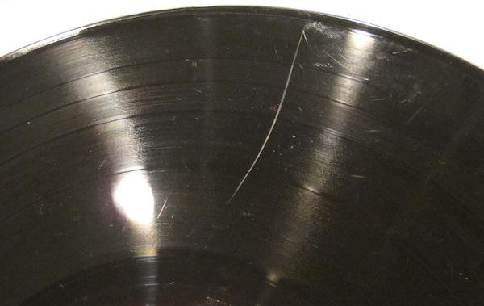
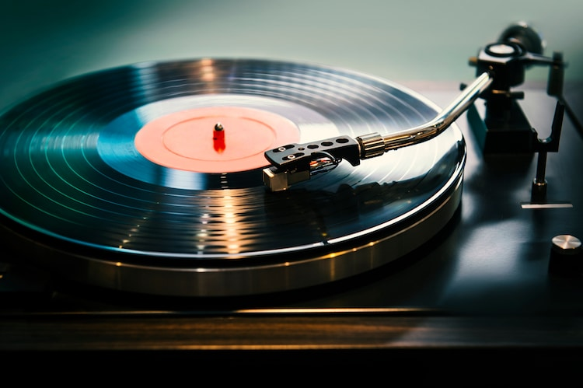

Slide 3
Paul’s Passion for: Jesus; The Gospel; Truth
Truth
Guard against lies
Gospel of Jesus Christ
Watch out for false Gospel
2 Corinthians and all
its warnings, are for our:
instruction
encouragement
formation into disciples of Christ
Build
the Church up

Slide 4
2 Corinthians 11 & 12
(English Standard Version)

Slide 5
(ESV) 11 I wish you would bear with me in a little foolishness. Do bear with me! ² For I feel a divine jealousy for you, since I betrothed you to one husband, to present you as a pure virgin to Christ. ³ But I am afraid that as the serpent deceived Eve by his cunning, your thoughts will be led astray from a sincere and pure devotion to Christ. ⁴ For if someone comes and proclaims another Jesus than the one we proclaimed, or if you receive a different spirit from the one you received, or if you accept a different gospel from the one you accepted, you put up with it readily enough.

Slide 6
⁵ Indeed, I consider that I am not in the least inferior to these super-apostles. ⁶ Even if I am unskilled in speaking, I am not so in knowledge; indeed, in every way we have made this plain to you in all things.

Slide 7
⁷ Or did I commit a sin in humbling myself so that you might be exalted, because I preached God’s gospel to you free of charge? ⁸ I robbed other churches by accepting support from them in order to serve you. ⁹ And when I was with you and was in need, I did not burden anyone, for the brothers who came from Macedonia supplied my need. So I refrained and will refrain from burdening you in any way. ¹⁰ As the truth of Christ is in me, this boasting of mine will not be silenced in the regions of Achaia. ¹¹ And why? Because I do not love you? God knows I do!

Slide 8
¹² And what I am doing I will continue to do, in order to undermine the claim of those who would like to claim that in their boasted mission they work on the same terms as we do. ¹³ For such men are false apostles, deceitful workmen, disguising themselves as apostles of Christ. ¹⁴ And no wonder, for even Satan disguises himself as an angel of light. ¹⁵ So it is no surprise if his servants, also, disguise themselves as servants of righteousness. Their end will correspond to their deeds.

Slide 9
¹⁶ I repeat, let no one think me foolish. But even if you do, accept me as a fool, so that I too may boast a little. ¹⁷ What I am saying with this boastful confidence, I say not as the Lord would but as a fool. ¹⁸ Since many boast according to the flesh, I too will boast. ¹⁹ For you gladly bear with fools, being wise yourselves! ²⁰ For you bear it if someone makes slaves of you, or devours you, or takes advantage of you, or puts on airs, or strikes you in the face. ²¹ To my shame, I must say, we were too weak for that!

Slide 10
But whatever anyone else dares to boast of — I am speaking as a fool — I also dare to boast of that. ²² Are they Hebrews? So am I. Are they Israelites? So am I. Are they offspring of Abraham? So am I. ²³ Are they servants of Christ? I am a better one — I am talking like a madman — with far greater labours, far more imprisonments, with countless beatings, and often near death. ²⁴ Five times I received at the hands of the Jews the forty lashes less one. ²⁵ Three times I was beaten with rods. Once I was stoned. Three times I was shipwrecked; a night and a day I was adrift at sea;

Slide 11
²⁶ on frequent journeys, in danger from rivers, danger from robbers, danger from my own people, danger from Gentiles, danger in the city, danger in the wilderness, danger at sea, danger from false brothers; ²⁷ in toil and hardship, through many a sleepless night, in hunger and thirst, often without food, in cold and exposure. ²⁸ And, apart from other things, there is the daily pressure on me of my anxiety for all the churches. ²⁹ Who is weak, and I am not weak? Who is made to fall, and I am not indignant?

Slide 12
2 Corinthians 11 & 12
Fool / Foolish / Foolishness (8)
Boast / Boasting / Boasted / Boastful (15)
Foolishness of Boasting
A Christian Heritage is a wonderful thing. But it’s nothing to boast about.
Being a servant for Christ, is firmly linked with suffering for Christ.
Good to suffer as a servant of Christ. But it is not to be boasted about.

Slide 13
³⁰ If I must boast, I will boast of the things that show my weakness. ³¹ The God and Father of the Lord Jesus, he who is blessed forever, knows that I am not lying. ³² At Damascus, the governor under King Aretas was guarding the city of Damascus in order to seize me, ³³ but I was let down in a basket through a window in the wall and escaped his hands.
12 I must go on boasting. Though there is nothing to be gained by it, I will go on to visions and revelations of the Lord.

Slide 14
2 Corinthians 11 & 12
Fool / Foolish / Foolishness (8)
Boast / Boasting / Boasted / Boastful (15)
Foolishness of Boasting
A Christian Heritage is a wonderful thing. But it’s nothing to boast about.
Being a servant for Christ, is firmly linked with suffering for Christ.
Good to suffer as a servant of Christ. But it is not to be boasted about.
When someone has an amazing Spiritual Experience, we might covet it / or we might honour them more or give them more credibility
A Spiritual dream / vision / revelation may be a wonderful experience. But not to boast about

Slide 15
² I know a man in Christ who fourteen years ago was caught up to the third heaven — whether in the body or out of the body I do not know, God knows. ³ And I know that this man was caught up into paradise — whether in the body or out of the body I do not know, God knows — ⁴ and he heard things that cannot be told, which man may not utter. ⁵ On behalf of this man I will boast, but on my own behalf I will not boast, except of my weaknesses — ⁶ though if I should wish to boast, I would not be a fool, for I would be speaking the truth; but I refrain from it, so that no one may think more of me than he sees in me or hears from me.

Slide 16
2 Corinthians 11 & 12
Fool / Foolish / Foolishness (8)
Boast / Boasting / Boasted / Boastful (15)
Foolishness of Boasting
Eloquence;
A Christian Heritage is a wonderful thing. But it’s nothing to boast about.
Being a servant for Christ, is firmly linked with suffering for Christ.
Good to suffer as a servant of Christ. But it is not to be boasted about.
When someone has an amazing Spiritual Experience, we might covet it / or we might honour them more or give them more credibility. We shouldn’t.
A Spiritual dream / vision / revelation may be a wonderful experience. But not to boast about
Evidence of a Godly Teacher
⁶ though if I should wish to boast, I would not be a fool, for I would be speaking the truth; but I refrain from it, so that no one may think more of me than he sees in me or hears from me.
What you see in me – Godliness – Fruit of the Spirit (a transformed, Godly character)
What you hear from me – Truth – The true Gospel – Proclaiming the True Jesus Christ

Slide 17
2 Timothy 4:3–4 (ESV)
³ For the time is coming when people will not endure sound teaching, but having itching ears they will accumulate for themselves teachers to suit their own passions, ⁴ and will turn away from listening to the truth and wander off into myths.

Slide 18
⁷ So to keep me from becoming conceited because of the surpassing greatness of the revelations, a thorn was given me in the flesh, a messenger of Satan to harass me, to keep me from becoming conceited. ⁸ Three times I pleaded with the Lord about this, that it should leave me. ⁹ But he said to me, “My grace is sufficient for you, for my power is made perfect in weakness.” Therefore I will boast all the more gladly of my weaknesses, so that the power of Christ may rest upon me. ¹⁰ For the sake of Christ, then, I am content with weaknesses, insults, hardships, persecutions, and calamities. For when I am weak, then I am strong.

Slide 19
2 Corinthians 11 & 12
Fool / Foolish / Foolishness (8)
Boast / Boasting / Boasted / Boastful (15)
Foolishness of Boasting
Eloquence;
A Christian Heritage is a wonderful thing. But it’s nothing to boast about.
Being a servant for Christ, is firmly linked with suffering for Christ.
Good to suffer as a servant of Christ. But it is not to be boasted about.
When someone has an amazing Spiritual Experience, we might covet it / or we might honour them more or give them more credibility. We shouldn’t.
A Spiritual dream / vision / revelation may be a wonderful experience. But not to boast about
Evidence of a Godly Teacher
What you see in me – Godliness – Fruit of the Spirit (a transformed, Godly character)
What you hear from me – Truth – The true Gospel – Proclaiming the True Jesus Christ
“My grace is sufficient for you, for my power is made perfect in weakness.”
Pray continually, until we get an answer
Be willing to receive the answer “No” to our prayer
We fail Jesus – weaknesses (physical; psychological; fear; sin; communication)
Our weakness – an opportunity to experience the power of God at work through us.

Slide 20
¹¹ I have been a fool! You forced me to it, for I ought to have been commended by you. For I was not at all inferior to these super-apostles, even though I am nothing. ¹² The signs of a true apostle were performed among you with utmost patience, with signs and wonders and mighty works. ¹³ For in what were you less favoured than the rest of the churches, except that I myself did not burden you? Forgive me this wrong!

Slide 21
¹⁴ Here for the third time I am ready to come to you. And I will not be a burden, for I seek not what is yours but you. For children are not obligated to save up for their parents, but parents for their children. ¹⁵ I will most gladly spend and be spent for your souls. If I love you more, am I to be loved less? ¹⁶ But granting that I myself did not burden you, I was crafty, you say, and got the better of you by deceit. ¹⁷ Did I take advantage of you through any of those whom I sent to you? ¹⁸ I urged Titus to go, and sent the brother with him. Did Titus take advantage of you? Did we not act in the same spirit? Did we not take the same steps?

Slide 22
¹⁹ Have you been thinking all along that we have been defending ourselves to you? It is in the sight of God that we have been speaking in Christ, and all for your upbuilding, beloved. ²⁰ For I fear that perhaps when I come I may find you not as I wish, and that you may find me not as you wish — that perhaps there may be quarrelling, jealousy, anger, hostility, slander, gossip, conceit, and disorder. ²¹ I fear that when I come again my God may humble me before you, and I may have to mourn over many of those who sinned earlier and have not repented of the impurity, sexual immorality, and sensuality that they have practiced.

Slide 23
Paul’s Passion for: Jesus; The Gospel; Truth
Defending himself
Comparing himself to false Apostles
Pointing them towards Jesus
2 Corinthians and all
its warnings, are for our:
instruction
encouragement
formation into disciples of Christ
Build
the Church up
We pray that our thoughts will not be led astray from a sincere and pure devotion to Christ. And that when Jesus returns, we will be the pure bride that He’s coming for

